Slide 1
A Longitudinal Analysis of housing sales in the Greater Toronto-Hamilton Area
Eric Miller
Dena Kasraian
Shivani Raghav
Stepan Oskin

Slide 2
Data Sources

Slide 3
Status and Issues
Spatial unit of analysis:
2016 Teranet parcel (~250k)
2016 Census DA (# 9183)
2001 Traffic Analysis Zone (# 1717)
Ignore changing parcel boundaries and PINs?
2010, 2012, 2014, 2016
Very high transaction values for different PINs in the same location

Slide 4
Status and Issues
Stratification based on year
Annual - missing Census and TTS variables
5-yearly - missing DAs due to null transactions
Attaching land use and POI data to parcel PINs
Detailed land use (housing typology, mixed use) for 2011 – Hamilton?
Generic land use for 2014
POI for 2013

Slide 5
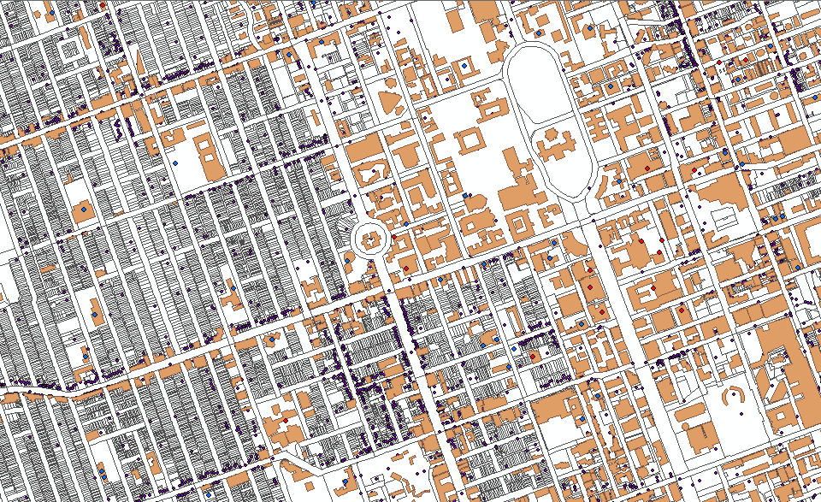
Building footprints and POI

Slide 6
Database Management System

Slide 7
Issues
Linking of data sources by primary keys
Teranet - Parcel PIN
Census - DAUID
TTS - TAZ_O
EPOI - POI_ID
Conversion of polygon based data
DA level to TAZ level
TAZ level to DA level
Parcel level to DA level
Server?

Slide 8
Organization Hierarchy
Data source
Year (1985 - 2016)
Attribute (Demographics, housing, employment, income etc.)

Slide 9
Teranet Data Flow

Slide 10
Data Flow for Teranet prep
Teranet dataset is transformed in 5 main stages:
(4.) Remove duplicates
(pending)
0.
1.
Correct
for
consistency
Add to the database
Raw
Teranet
data
2.
3.
final
Add foreign
keys via spatial joins
Add new attributes
HHSaleHistory.csv
2_Teranet_consistent.csv
PostgreSQL
1.1_Teranet_DA_cols.csv
3_Teranet_new_cols.csv
1.2_Teranet_DA_TAZ_cols.csv
3_Teranet_nonan_new_cols.csv

Slide 11
Data Flow for Teranet prep
Performed in Python in 3 steps:
2.1.1_teranet_gtha_da_spatial_join.ipynb
2.3_teranet_new_cols.ipynb
2.1.2_teranet_taz_spatial_join.ipynb
2.3_teranet_nonan_new_cols.ipynb
2.2_teranet_consistency.ipynb
0.
1.
Correct
for
consistency
Add to the database
Raw
Teranet
data
2.
3.
final
Add foreign
keys via spatial joins
Add new attributes
HHSaleHistory.csv
2_Teranet_consistent.csv
PostgreSQL
1.1_Teranet_DA_cols.csv
3_Teranet_new_cols.csv
1.2_Teranet_DA_TAZ_cols.csv
3_Teranet_nonan_new_cols.csv

